Slide 1
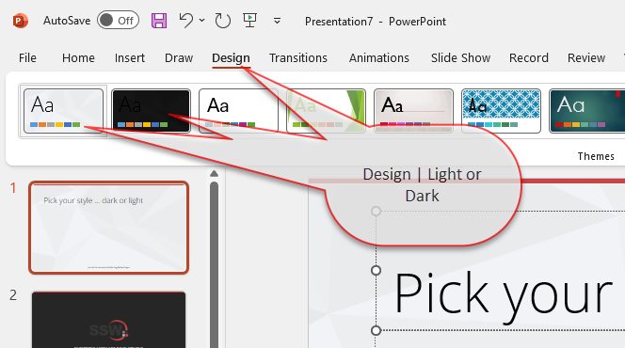
Pick your style … dark or light

Slide 2
Setup steps
Zoom 150%
Browser window
IDE
Open Vercel Talk space on Arc
GitHub link to Repository
Vercel Home page (logged out)
Link to Live deployed Demo
Link to Personal site
Notes
Open Postman Collection

Slide 4
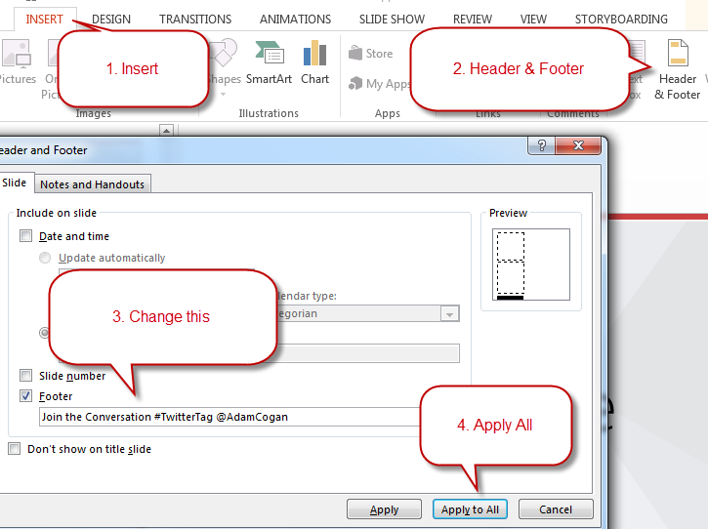
Change the Footer
Make sure you don’t forget the footer. Everyone forgets the footer.
TIP: If your content interferes with the footer you can slide it to one side.

Slide 5
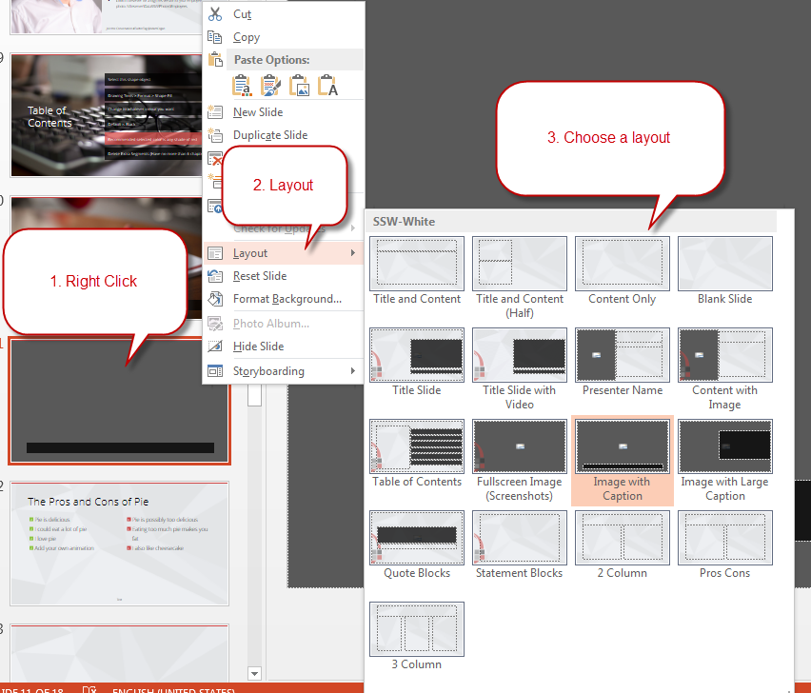
Use Different Slide Layouts
Make sure you’re using the template correctly with slide layouts.

Slide 6
SSW Template
Version 4.1 by SSW Design Tip: Slides have additional info in View | Notes.
Notes:
V4.0 Beautified by Jayden

Slide 7
















Icon Library
These icons are pulled from http://fontawesome.com
Feel free to use your own by pasting in any SVG. You can use PowerPoint to recolor SVGs (Right Click > Fill).

Slide 8




Other Icons
Here are some little red people and other items!
ssw.com.au/rules/do-you-use-standard-question-mark-when-you-are-going-to-ask-the-audience-something
Question Man Demo Man Bad Example Good Example

Slide 9

Adding logo watermark
If you want the logo overlap as shown in the template, you’ll need the logo in the bottom right of this slide. Just copy paste it onto relevant slides.

Slide 10
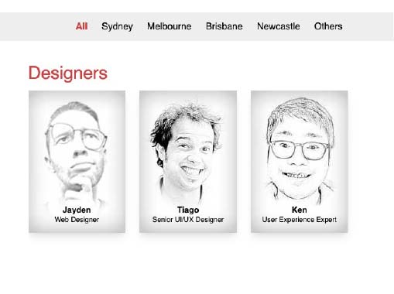
Has a Presentation Master & designer done a Test Please on your slides and content?
This layout is made for a screenshot with some descriptive text. A brave Designer did this so you wouldn’t have to.
Notes:
https://www.ssw.com.au/rules/pptx-test-please/
https://www.ssw.com.au/rules/conduct-a-test-please-internally-and-then-with-the-client

Slide 11
Vercel – Simplifying your development with zero configuration
.NET User Group October 2023

Slide 12

Tylah Kapa
@jadekapa
Stalk 👀 ssw.com.au/people/tylah-kapa
Walk 📍 ssw.com.au/ssw/company/offices
SSW Software Engineer
Broke an arm while arm-wrestling
Bad at kickboxing
Collects expensive cardboard

Slide 13
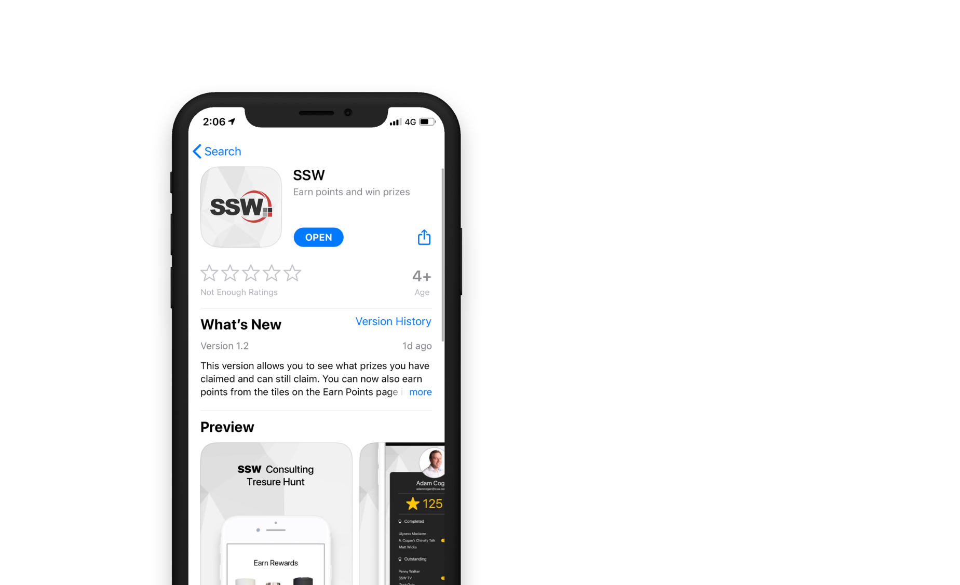

Scan QR Code to install app
Scan SSW codes at talks and events
Earn SSW Points
claim rewards, and win prizes
SSW Rewards
Notes:
An SSW Admin will give you your QR code https://my.sugarlearning.com/SSW/items/13946/ssw-rewards-setup-the-ssw-rewards-app

Slide 14


Agenda
1. What started this journey?
2. What is Vercel and NextJs?
3. Vercel Demo
4. How does Vercel compare?
5. Summary

Slide 15
Have you ever failed to launch on a side project?

Slide 16

Requirements
Blog site
Easy to stand up
Easy to maintain and update
Good analytics
Static Site Generation
$FREE.99
Notes:
Blog site
Easy to stand up
Easy to maintain and update
Good analytics
Static Site Generation
$FREE.99

Slide 17

”How would I do that?”
Create Repo
Create Azure Resources
Setup GitHub Actions
Sadness
Debug…
Notes:
TODO: Update to a flow chart on My thoughts on the matter
Azure
Create Repo
Create Azure Resources
(Static Web App, App Insights etc.)
Setup GitHub Actions
Debug
Sadness

Slide 18
Agenda
1. What started this journey?
2. What is Vercel and NextJs?
3. Vercel Demo
4. How does Vercel compare?
5. Summary

Slide 19
What is Vercel?
End-to-end platform
Deployments
CI/CD
Analytics
Edge Functions
Officially supports many JS frameworks
Created by NextJs devs
Notes:
Marketed as an E2E platform
Takes care of deployments and CI/CD
Built-In Analytics
Edge Functionality – Running your API functions local to the user
Officially supports many JS Frameworks OOB
Primarily NextJs, as Vercel was created by NextJs devs

Slide 20
What is NextJs?
Powerful React Framework
Benefit from ISR and SSG
Typescript integrated
API Routes
CSS, Image and font optimization
Notes:
Powerful React Framework
Benefit from Incremental Static Regeneration and Static Site Generation
Typescript Integrated (I just like Typescript)
API Routing – Build API endpoints for your website without needing to write a separate app
NextJs also has
Built in support for optimizing CSS images and fonts to reduce load times and improve your performance

Slide 21
Agenda
1. What started this journey?
2. What is Vercel and NextJs?
3. Vercel Demo
4. How does Vercel compare?
5. Summary

Slide 22
Agenda
1. What started this journey?
2. What is Vercel and NextJs?
3. Vercel Demo
4. How does Vercel compare?
5. Summary

Slide 23
How does Vercel compare?
Scalability
Performance
Edge functionality
Ease of use
Focus on development
Incredible free features
(Mostly) Locked into NodeJs
Front-End focus
Less CI/CD opportunity
Pro pricing is per user/month
Notes:
Pros:
Scalability – Being able to take these apps, and even create multi-tenant applications
Performance – You’ve seen how quickly you can iterate using Vercel
Edge Functionality – Being able to run functions closer to your end user to take advantage of Vercel’s Edge Functions
Ease of Use – You’ve seen just how easy it is to get started with Vercel
Focus on Development – You can just focus on getting your app feature complete with minimal effort
Suite of free features – It’s crazy what you can get for free using Vercel
Cons:
(Mostly) Locked into NodeJs
Front-End focus and Less CI/CD Opportunity – If you’re looking to improve in back-end or CI/CD, Vercel may not be for you
Pro pricing is per seat/month – Which could mean that a service like Azure could end up running cheaper for you. But you will need to take that extra effort to set up these default features on Vercel.

Slide 24
Agenda
1. What started this journey?
2. What is Vercel and NextJs?
3. Vercel Demo
4. How does Vercel compare?
5. Summary

Slide 25

“Unfortunately, we no longer have an excuse to not get those side projects going."
- Tylah Kapa, tiredly

Slide 26

Notes:
If you want to learn more about NextJs and Vercel, you’re in luck! Kinda
10AM Oct 26th for AEDT
3AM Oct 27th for AEDT
NextJs Conf is just around the corner this month!

Slide 27
Resources
Vercel Documentation
vercel.com/docs
Supported Frameworks on Vercel
vercel.com/docs/frameworks
Migrating from Gatsby to NextJs – Daniel Mackay
dandoescode.com/blog/migrating-from-gatsby-to-nextjs
Next.js in 100 Seconds // Plus Full Beginner’s Tutorial
youtube.com/watch?v=Sklc_fQBmcs
Rules to better NextJs
ssw.com.au/rules/rules-to-better-nextjs/

Slide 28


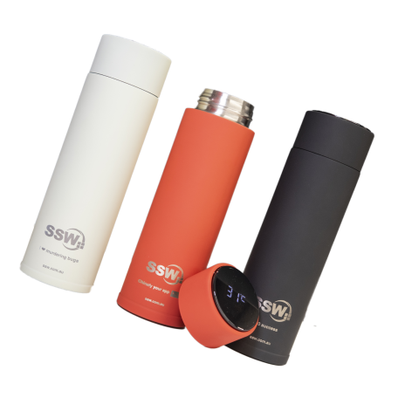

Scan the QR code below and earn
SSW Points for watching this talk!

Slide 29

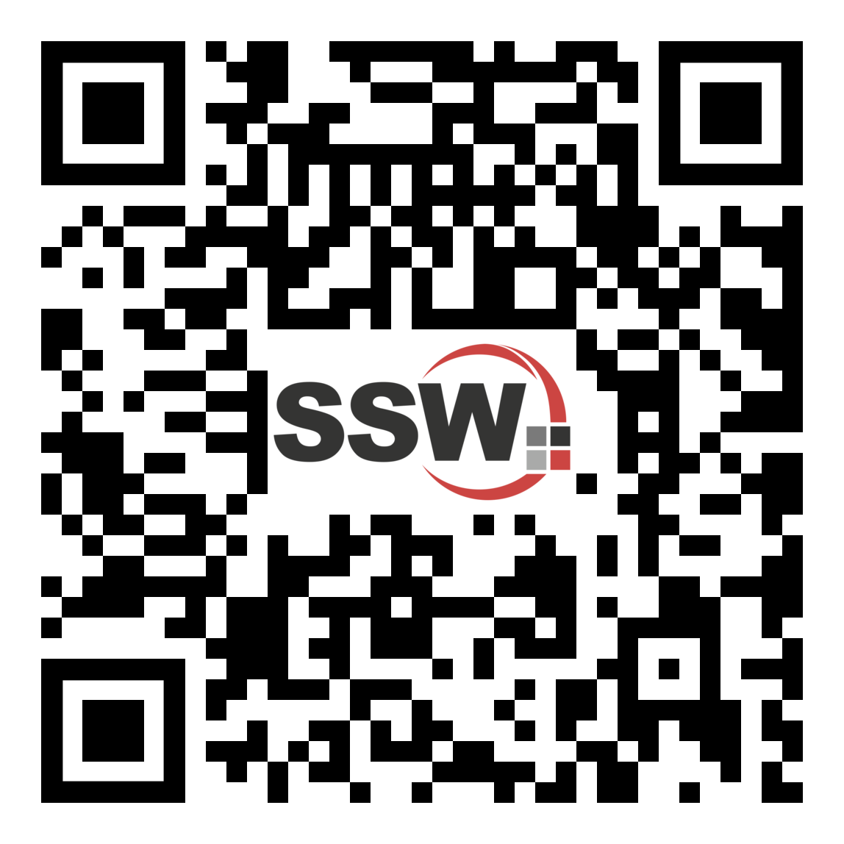
Got feedback?
Earn SSW points by filling out our survey.
Vercel – Simplifying your development with zero configuration with Tylah Kapa
Notes:
TODO: Get new Survey code

Slide 30
Summary
1. What started this journey?
2. What is Vercel and NextJs?
3. Vercel Demo
4. How does Vercel compare?
5. Summary

Slide 31

Find this presentation on GitHub!
github.com/tkapa/oct-ug-ppt
Notes:
https://www.ssw.com.au/rules/do-you-keep-your-presentations-in-a-public-location
Example slides: https://github.com/Hona/BlastOffWithBlazor.Demos/raw/main/Presentation.pptx

Slide 32

Thank you! info@ssw.com.au www.ssw.com.au Sydney | Melbourne | Brisbane | Newcastle
Notes:
Note: You should say “thank you” and then pause for 4-5 seconds… to give the audience time to applaud!
https://www.ssw.com.au/rules/do-you-finish-your-presentation-with-a-thank-you-slide

Slide 33
Questions? info@ssw.com.au www.ssw.com.au Sydney | Melbourne | Brisbane | Newcastle
Notes:
Note: You should pause for applause here!
https://www.ssw.com.au/rules/do-you-finish-your-presentation-with-a-thank-you-slide

